Slide 1
Package in Java
Package is the mechanism of collection of classes and interfaces at a single place.
A package in Java is used to group related classes and Interfaces. Think of it as a folder in a file directory. We use packages to avoid name conflicts, and to write a better maintainable code. Packages are divided into two categories:
Built-in Packages (packages from the Java API)
User-defined Packages (create your own packages)

Slide 2
Built-in Packages
The Java API is a library of prewritten classes, that are free to use, included in the Java Development Environment.
The library is divided into packages and classes. Meaning you can either import a single class (along with its methods and attributes), or a whole sub package that contain all the classes that belong to the specified sub package.
To use a class or a package from the library, you need to use the import keyword. Syntax :
import package.subpackage.Class; // Import a single class
import java.util.Scanner;
import package.subpackage.*; // Import the whole sub package
import java.util.*;

Slide 3
User-defined Packages
User-defined packages are those packages, which are created by user.
To create your own package, you need to understand that Java uses a file system directory to store them. Just like folders on your computer:
Example
└── root
└── mypack
└── MyPackageClass.java
To create a package, use the package keyword.

Slide 4
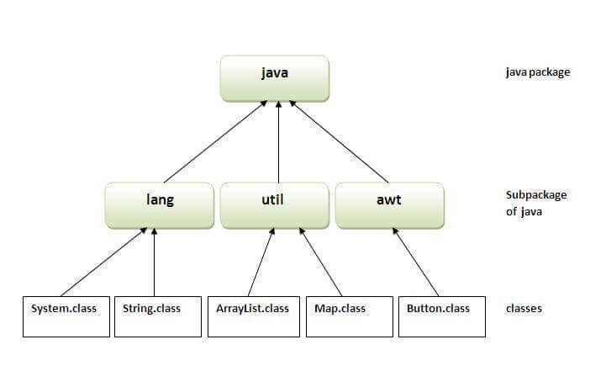
Predefined Packages

Slide 5
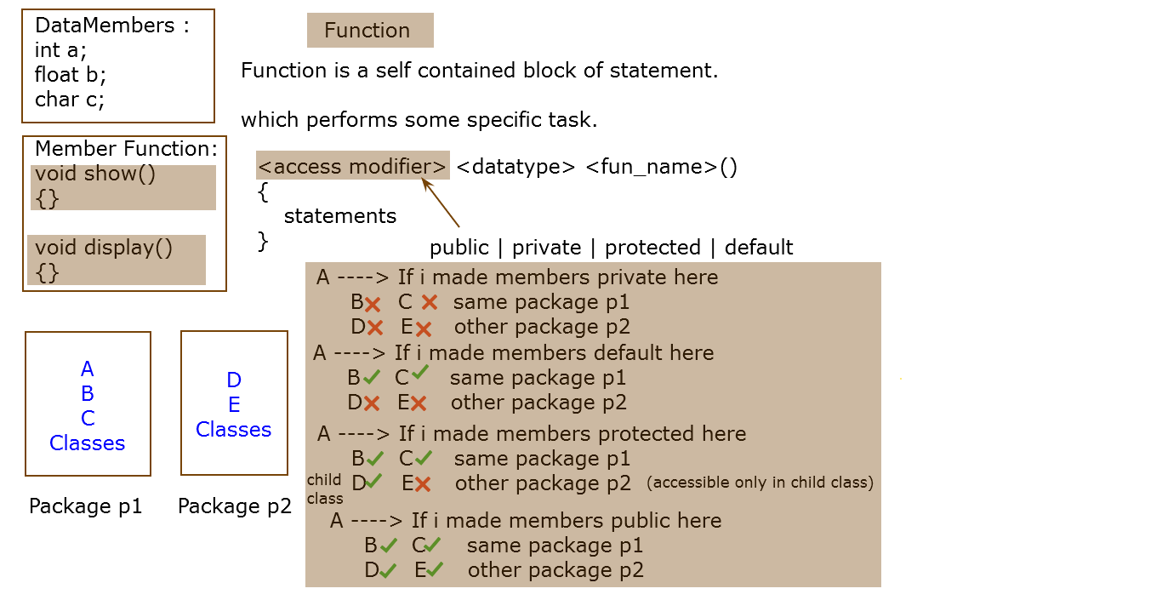
(accessible in same class)
(accessible in same class)
(accessible in same class)
(accessible in same class)

Slide 6
How to run java package program in Notepad
The package keyword is used to create a package in java.
Create a file named Simple.java in package(folder) mypack and mention package mypack; in program ,then
To Compile: javac -d . Simple.java
To Run: java mypack.Simple
You need to use fully qualified name e.g. mypack.Simple etc to run the class.
The -d is a switch that tells the compiler where to put the class file i.e. it represents destination. The . represents the current folder.
You can use any directory name like /home (in case of Linux), d:/abc (in case of windows) etc. If you want to keep the package within the same directory, you can use . (dot).

Slide 7
How to send the class file to another directory or drive?
To Compile:
e:\sources> javac -d c:\classes Simple.java
To Run:
To run this program from e:\source directory, you need to set classpath of the directory where the class file resides.
e:\sources> set classpath=c:\classes;.;
(if class files present in c:\classes; and in current folder also because . (dot) represents current folder)
e:\sources> set classpath=c:\classes;
(if class file present in c:\classes;)
e:\sources> java mypack.Simple
Note : Run it on Command Prompt

Slide 8
Creating executable jar file using jar tool
The jar tool provides many switches, some of them are as follows:
-c creates new archive file
-v generates verbose output. It displays the included or extracted resource on the standard output.
-m includes manifest information from the given mf file.
-f specifies the archive file name
JAR stands for Java ARchive. It's a file format based on the popular ZIP file format.

Slide 9
Write on Notepad
C:\Users\kotharigaurav\foldername>jar -cvf myjar.jar Demo.class
Demo.class : no such file or directory
added manifest
C:\Users\kotharigaurav\foldername>javac Demo.java
C:\Users\kotharigaurav\foldername>jar -cvf myjar.jar Demo.class
added manifest
adding: Demo.class(in = 416) (out= 288)(deflated 30%)

